Slide 1
Web Services and SOA
Gary Clynch,
Dept. Of Computing,
ITT Dublin

Slide 2
SOA Introduction
SOA = “an architecture for enterprise computing based on loosely coupled, coarse grained services” - SaaS
Architectural principle for structuring systems
Publish/Find/Bind pattern
Web services are a realisation of the abstract SOA platform (REST is an alternative realisation)

Slide 3
SOA Motivation
Business drivers:
  Integration of different organisations:
    Outsourcing of non-core operations
    Mergers and acquisitions
    Interaction with partners and suppliers
    Providing access to business processes to customers
Cost of maintenance of links between systems is high

Slide 4
SOA Motivation
Business Integration is not new
  EDI used in the past, later XML, later EBXML
  SOA is a standard and cross platform approach
Technical drivers:
  Advances in Middleware
  Success and failure of distributed objects
  Moves towards standardisation and cross-platform interoperability

Slide 5
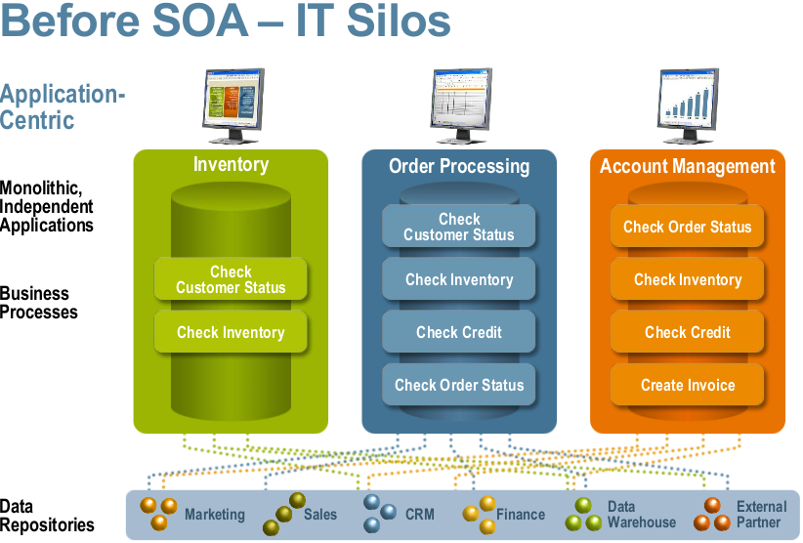
Before..

Slide 6
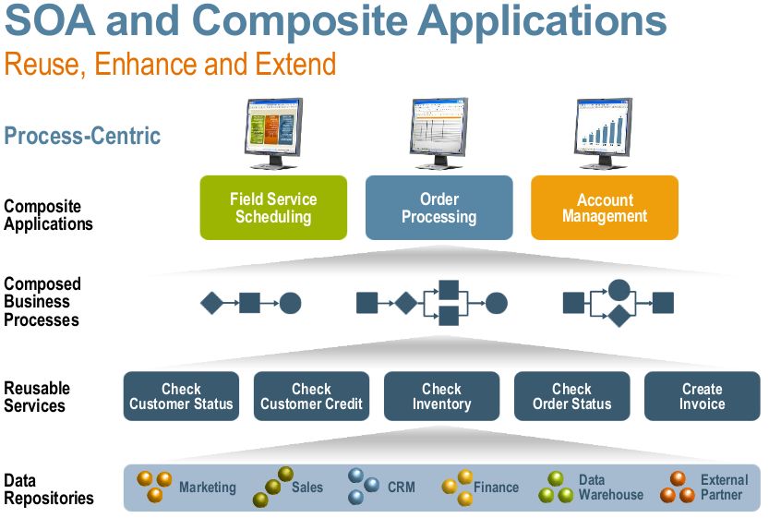
After..

Slide 7
Services
What is a service?
  “a publicised package of functionality”
  “a business process”
Service features:
  Available at an endpoint in a network (e.g. URL)
  Receives and sends messages (e.g. SOAP)
  Has specified functionality (service definition e.g. WSDL)
  Has usage policy (e.g. WS-Policy)
  Has QoS characteristics (transactions, security, reliable messaging)

Slide 8
SOA Principles
Services in a SOA platform should be:
  Coarse grained
  Autonomous
  Re-useable
  Loosely coupled
  Discoverable
  Composeable
SOA =
  An architectural principle for structuring systems
  Emphasis on de-coupled services
  New services can be created from existing ones in a synergistic fashion

Slide 9
WS Definition
A Web Service
  “a software component designed to support interoperable machine-to-machine interaction over a network” – W3C
  traditionally SOAP (XML) over a http transport
  an interface described in a machine-processible format (i.e. WSDL)
  Clients interact with the Web service in a manner prescribed by its description using SOAP messages
Standards based (managed by W3C & OASIS)‏
Killer App? Integration?

Slide 10
WS architecture
Service
Requester
Service
Provider
Bind
Find
Publish
Service
Registry

Slide 11
WS Evolution
1st generation:
  SOAP, WSDL, UDDI
2nd generation (WS-* platform) :
  WS-* specifications (OASIS, W3C)
    WS-Addressing
    WS-Policy
    WS-Security
    WS-Reliable-Messaging
    WS-Coordination
    WS-BPEL
    etc. etc. etc.
WS-I profiles

Slide 12
SOAP
SOAP messages are the “lingua franca” of web services
SOAP is XML, SOAP 1.2 – W3C Recommendation 2003
“lightweight exchange of XML information in a distributed environment”
SOAP Message structure:
  Envelope containing
    headers (optional) – metadata (QoS)
    body (message payload)
SOAP binding e.g. http, https, tcp etc, can vary over a journey

Slide 13
SOAP
SOAP MEPs (Message Exchange Patterns)
  Request/Response
  One way (“fire and forget”)
  + others
SOAP nodes on message path
  Sender (creates message)
  Receiver (processes headers & body)
  Intermediary (may process headers)
  Possibly different bindings for each hop

Slide 14
SOAP
SOAP faults (optional)
  SOAP message containing a fault element (as part of body)
  Holds error information
SOAP attachments
  SOAP MTOM/XOP
    Binary data kept as separate chunks at end of SOAP document

Slide 15
SOAP request HTTP binding
POST /GetStockQuote HTTP/1.1
Host: www.stockquote.com
Content-Type: application/soap+xml; charset=utf-8
Content-Length: 123
<?xml version='1.0' ?>
<S:Envelope xmlns:S="http://www.w3.org/2003/05/soap-envelope">
<!--a sample SOAP request for stock price of IBM, no header blocks-->
<S:Body>
<SQ:StockRequest xmlns:SQ="http://www.stockquote.com/stock">
<SQ:StockName>IBM</SQ:StockName>
</SQ:StockRequest>
</S:Body>
</S:Envelope>

Slide 16
SOAP response HTTP binding
HTTP/1.1 200 OK
Content-Type: application/soap+xml; charset=utf-8
Content-Length: 123
<?xml version='1.0' ?>
<S:Envelope xmlns:S="http://www.w3.org/2003/05/soap-envelope">
<!--a sample SOAP response, stock price is 34.5-->
<S:Body>
<SQ:StockResponse xmlns:SQ="http://www.stockquote.com/stock">
<SQ:StockPrice>34.5</SQ:StockPrice>
</SQ:StockResponse>
</S:Body>
</S:Envelope>

Slide 17
WSDL
WSDL 2.0 is a W3C recommendation
WSDL 1.1 – de facto standard
Metadata which fully describes a service’s characteristics
“WSDL is an XML grammar for describing network services as collections of communication endpoints capable of exchanging messages”
Used as basis for generation of client proxies/stubs

Slide 18
WSDL
WSDL specifies functional behaviours
WSDL for a service defines:
  “what” – operations
  “how” – protocol and format
  “where” – URL for endpoint (port)
WSDL does not specify service semantics i.e. internal behaviour (c.f. OWL-S)

Slide 19
WSDL Documents
A Service is a collection of Ports (endpoints)
A Port is a network address and a Binding
A Binding is a concrete protocol and formatting for a Port Type
A Port Type is a set of abstract Operations
An Operation processes Messages in a pattern (one-way, request-response etc.)
Messages are typed data structures (XML Schema)

Slide 20
MetaData Exchange
WS-MetaData Exchange (MEX) (2006)
  Dynamic discovery of metadata direct from endpoint for a service (bypass UDDI registry) via SOAP
  Metadata dialects that can be discovered:
    WSDL
    WS-Policy definitions
    XML Schemas (for messages exchanged)
    + extensions e.g. semantic info. etc.
  Request can be dialect specific or generic (all)
  Transport protocol neutral

